Slide 1

SRM INSTITUTE OF SCIENCE AND TECHNOLOGY
FACULTY OF ENGINEERING AND TECHNOLOGY
DEPARTMENT OF COMPUTER SCIENCE ENGINEERING
15CS496L MAJOR PROJECT
Identifying the Sustainability of a product at an optimal cost by Data Analytics using an Integrated LCA-SCM model
PRESENTED BY
DEBANJANA CHAKRABORTY (RA1711003010212)
SUPARNO BHATTA (RA1711003010172)
Batch ID: CSE1720212
GUIDE: Dr. E. POOVAMMAL, PROFESSOR

Slide 2
Table of Contents
Abstract
Introduction
Literature Survey
Inference from the Survey
Objective of the project
Architecture Diagram
UML Diagram
Module Description
Algorithms used
Implementation
Results and Discussions
Appendix (Screenshots)
References
Publication Details

Slide 3
Abstract
Globalization - unleashed a new era of prosperity in economic terms.
Recent surge of consumption in the past few decades has led to the escalation in the production of goods.
Increasing overconsumption of resources has created a sense of urgency to track the level of expenditure as well emissions from a product.
This project tries to use Big data analytics to investigate the cost of manufacturing and sustainability of the product by looking into existing LCA and SCM models.

Slide 4
Introduction
The escalation in the commutation of people and transportation of raw materials has led to a towering consumption of fuel that has led to an increase in the pollution levels in the environment.
The rise in industrialization due to globalization has led to air, water, land, radioactive, noise, light, and thermal pollution.
This has resulted in an unregulated rise in prices of products and services thereby plummeting a dent in the consumption and expenditure, allowing dominance of capitalism like it never has before.
Priority - to identify opportunities to reduce material and energy costs from a product system.
This project tries to establish a model that could look into the concerns by developing an integrated model that would not only measure the environmental impact but would also keep track of the profit and supply chain demand of a product.

Slide 5
LITERATURE SURVEY
SL. NO. | TITLE | METHODOLOGY USED | DISADVANTAGES | AUTHOR AND PUBLICATION
1 | Life Cycle Assessment Model: Recent Development and Future Tendency | Talks about the strengths and weaknesses of the current LCA models | The models provided are are very complicated and time consuming. Not suitable for manufacturing section. Cannot place emphasis on local/regional data | Liu, Zhi-Chao & Jiang, Qiuhong & Zhang, Hong-Chao. (2012). Life Cycle Assessment Model: Recent Development and Future Tendency.
2 | A knowledge-based approximate life cycle assessment system for evaluating environmental impacts of product design alternatives in a collaborative design environment | Uses knowledge-based approximate model to the environmental impacts of product design alternatives using artificial neural network | The model is based on object oriented model so adequate knowledge has to be present with the user to use the software. It is a very costly software. | Ji-Hyung Park, Kwang-Kyu Seo, Advanced Engineering Informatics, Volume 20, Issue 2, 2006, Pages 147-154

Slide 6
SL. NO. | TITLE | METHODOLOGY USED | DISADVANTAGES | AUTHOR AND PUBLICATION
3 | Extension of Computer-Aided Process Engineering Applications to Environmental Life Cycle Assessment and Supply Chain Management | computer-aided process engineering (CAPE), using XML, SimaPro 5, TEAM 3.0, KCL-ECO, Umberto, EcoSpold | Mostly difficult to gather data and has less software dependability | William M. Barrett, Svetlana Strunjaš-Yoshikawa, Jonathan H Bell, 17th European Symposium on Computer Aided Process Engineering – ESCAPE17
4 | A modular framework for the LCA-based simulation of production systems | Uses modular model to check the consumption of the product both in stationary or dynamic phase. | Accuracy of the data depends on the accuracy of the initial data, So any uncertainty in the initial phase can give an inaccurate result. Information for data used in multiple processes is different for different operations of a single product. | C. Brondi, E. Carpanzano, ITIA-CNR Institute for Industrial Technologies and Automation, National Research Council, 15 via Bassini, 20133 Milan, Italy
5 | Risk based life cycle assessment conceptual framework for energy Supply systems in large buildings | To analyze the risk level in construction and operation purpose.. | They do not consider the role of stakeholder in decision making.It doesn't take in consideration all data of LCA. It just focuses on specific problems. | Nasser Ayoub, Farayi Musharavati, Shaligram Pokharel, Hossam A. Gabbar, Journal of Cleaner Production, Volume 107, 2015, Pages 291-309,

Slide 7
SL. NO. | TITLE | METHODOLOGY USED | DISADVANTAGES | AUTHOR AND PUBLICATION
6 | Proposing an integrated LCA-SCM model to evaluate the sustainability of customisation strategies | This paper propose a new integrated model which looks into the environmental factors( LCA )and sustainability (SCM) of a customized product developed by the company. | It lacks a parametric inventory to model different customized products. This model claims is for a specific product but customization requires us to make different products at different time. | Rosanna Fornasieroa, Carlo Brondia and Davide Collatinaa, International Journal of Computer Integrated Manufacturing, 2017
7 | Predictive Analytics in Reverse Supply Chain Management Commodity Life Expectancy for Quality Engineering | Chi-Squared Distribution Reliability, Hazard Function WEIBULL Analysis | Difference in theoretical and practical analysis Goodness of fit need to be performed prior to select survival method being applied which is not always possible. | Alfred Degbotse, Ai Kiar Ang, Ngoc Quy Vuong, Julian SK Tan, 2017 19th Electronics Packaging Technology Conference
8 | Data Mining and Data Warehousing for Supply Chain Management | Kernel - Support Vector Machine (Gaussian, Laplacian, Polynomial and Sigmoid Kernels) | Optimal design for multiclass SVM classifiers can be used to improve accuracy and quality of the prediction as it isn’t optimal till now | Shridhar Kamble, Aaditya Desai and Priya Vartak, 2015 International Conference on Communication, Information & Computing Technology (ICCICT), Jan. 16-17, Mumbai, India

Slide 8
SL. NO. | TITLE | METHODOLOGY USED | DISADVANTAGES | AUTHOR AND PUBLICATION
9 | Economic Input/Output Analysis to Aid Life Cycle Assessment of Electronics Products | Economic input/output (EIO) analysis | EIO-LCA approach is the difficulty of differentiating product types and processes used within any particular industry. The SETAC-LCA relies on specific models of products and processes, whereas EIO-LCA focuses on industry level outputs. | Elisa CohaS, Chris Hendrickson, Lester Lave and Francis McMichaell, 1995 IEEE International Symposium on Electronic and the Environment Proceedings, Orlando, FL
10 | Proposing an integrated LCA-SCM model to evaluate the sustainability of customisation strategies | Modular LCA approach | The complexity of evaluating the environmental impact of SC modelling seems to require novel methodologies to properly identify the key decisional areas. Such shifts can require a parametric inventory to model a customised production. When the inventory is based on a production batch, such evaluation can include different variables by resulting more in line with mass and energy balance at the SC level. | Rosanna Fornasiero, Carlo Brondi & Davide Collatina (2017), International Journal of Computer Integrated Manufacturing, 30:7, 768-781

Slide 9
Inference from the Survey
The survey on the existing LCA and SCM models provided a basic understanding on the method of assessing environment quality and supply chain demand of a product.
However there is significant lack of information technology resources across companies in the supply chain network
Poor data generation and management that is essential for the development of a product .
They sound technical in theory but didn’t produce any optimal results when tested practically.

Slide 10
Inference from the Survey
Lack in novel methodologies that could identify the decisional areas that are necessary to differentiating product types, quality and their sustainability
Lagging in the technical or logical processes that are essential to identify the new patterns of consumption, emission, profit margin and also accuracy of the model.
Need for focus on integrated model that emphasize on:completeness, consistency, accuracy and timeliness, relevancy, value, quantity, accessibility and reputation of data dimensions

Slide 11
I
Objective
To establish a model that could look into the concerns by developing an integrated model on Life Cycle Assessment and Supply Chain Management that would focus on improving the cost and quality right from the raw phase.
Measure the environmental impact + keep track of the profit and supply chain demand of products in companies.
Helps manufactures to identify opportunities to reduce material and energy costs from a product system.
To put special emphasis on cradle to gate phase (raw procurement products, manufacturing, production, and selling).

Slide 12
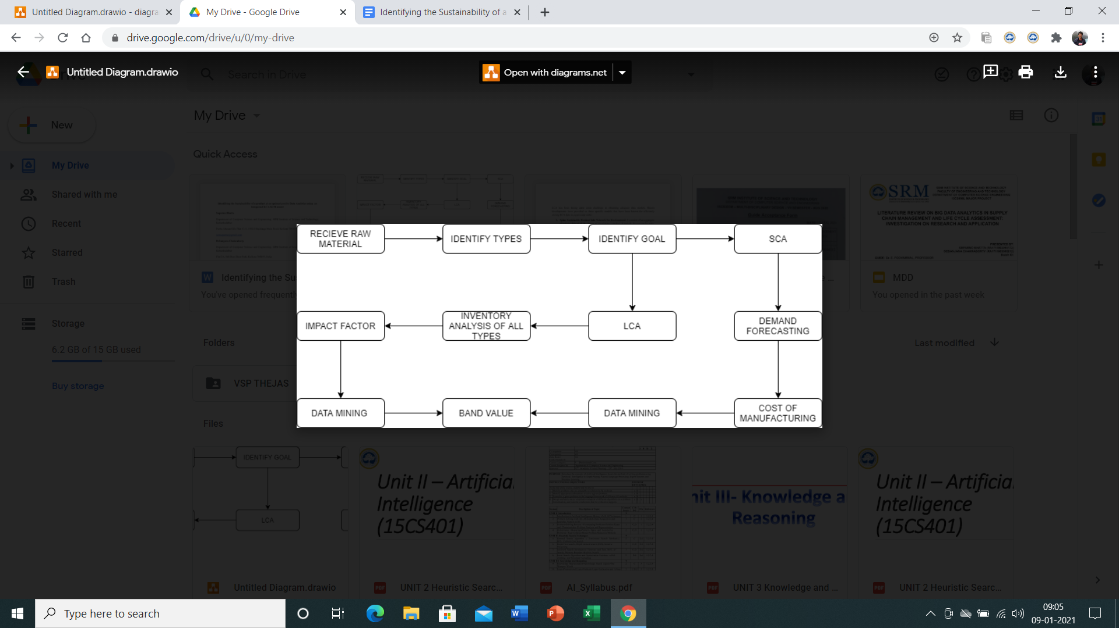
Architecture Diagram

Slide 13
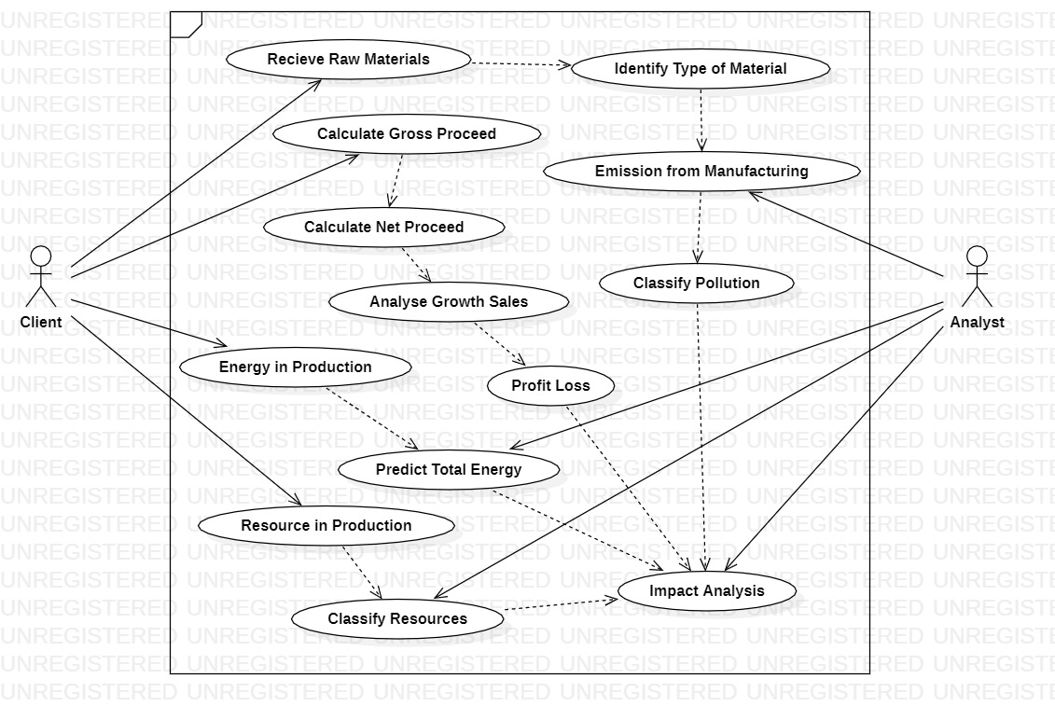
UML DIAGRAM

Slide 14
Module Description
Google Colab:
Allows anybody to write and execute arbitrary python code through the browser.
Is especially well suited to machine learning, data analysis and education.
Scikit-learn:
Free software machine learning library for the Python programming language.
Features various classification, regression and clustering algorithms including support vector machines, random forests, gradient boosting, k-means is designed to interoperate with the Python numerical and scientific libraries NumPy and SciPy.

Slide 15
Regression
Predictive modelling technique that help us to describe the relationships between a set of independent variables and the dependent variable.
Produces a regression equation where the coefficients represent the relationship between each independent variable and the dependent variable.
a) Linear Regression:
Helps in predicting the net profit/loss of a company based on the sale of the raw materials for manufacture purpose.
Gives good results for predictive analysis where we have 1 dependent and 1 independent variable.
Good for forecasting effect, and determining the strength of the predictor.

Slide 16
b) Huber Regression:
Huber regression is a regression technique that is robust to outliers.
Uses a different loss function compared to the usual least square method.
Seems usual to have the least squares penalty for little residuals of loss but on big residuals, its penalty is lesser and it linearly surges rather than quadratically.
Hence, it works well for datasets having enormous outliers.

Slide 17
c) Ridge Regression:
Ridge Regression analyzes multiple regression data that has severe multicollinearity.
Least squares method estimates are unbiased when multicollinearity occurs but their variances are huge that can mean that it may be far from the true value.
Reduces the standard errors by adding a degree of bias to the regression estimates.

Slide 18
Implementation
To create a user dataset on single use plastic:
Obtained a data set containing a list company, no. of single use plastic consumed by the company, Net Proceed, VAT and Gross Proceed.
Calculated the amount of energy consumed while manufacturing those single use plastic.
Calculated the amount of natural resources used while manufacturing those single use plastic.
Calculated the amount of emission from pollutants.
The dataset is ready.

Slide 19
Formula:
We know that the weight of single use plastic (K=0.005kg)
To calculate the total weight of plastic (W),we multiply no of single use plastic (N)with 0.005kg (W=N*0.005kg)
We have been provided with energy consumed/natural resource used/emission produced in GJ per 1,000 kilograms (E/1000).
Unitary method can be used on the energy value and total weight of each single use plastic to obtain the total energy/natural resource/emission produced or consumed (W*E/1000).

Slide 20
2. Data set cleaning:
Look for the missing or irrelevant values
Look for duplicate values and remove them
Converted the data types from nominal to numerical
Replaced missing values with 0

Slide 21
3. Perform Data Mining using Scikit learn:
Opened Google Colab notebook.
Imported the dataset in the drive and mount the Google Colab in the same drive.
Set the path in python for accessing the dataset.
Took all the inputs required using feature and set the target values for prediction.
Imported Numpy library for converting the data from csv and to analyze data in table format.

Slide 22
Set the training and testing data and split them based on 70:30 ratio.
Imported scikit learn library to perform data mining in Python.
Performed Regression analysis using Linear Huber and Ridge Regression.
Checked for model score to obtain the accuracy of the mining technique.
Obtained the prediction values.

Slide 23
4. Graph Visualization:
Compared the real and predicted values obtained from the target result.
Visualized the results using line graph.
Performed impact analysis based on:
a) Ecological system effect
b) Resource depletion
c) Human health
d) Overall profit/loss

Slide 24
5. Using the obtained graph we are trying to analyze the data set for:
Annual gross expenditure of all companies to manufacture and buy single use plastic.
Amount of energy and non renewable resources used in the manufacturing phase.
Amount of greenhouse and non greenhouse emission taking place due to the manufacturing of single use plastic.

Slide 25
Results and Discussions
Sales Inference
Keywords
The sales graph compares No. of Single Use Plastic, Net Proceed, VAT and Gross Proceed.
Based upon Calculation: Gross Proceed = Net proceed + VAT (Gross>>Net Proceed)
Gross Proceed: Average Expenditure of the company in Manufacturing single use plastic.
Net Proceed: Average Expenditure of the manufacturer in making the Plastic.
VAT: Government Tax on Single Use Plastic.

Slide 26
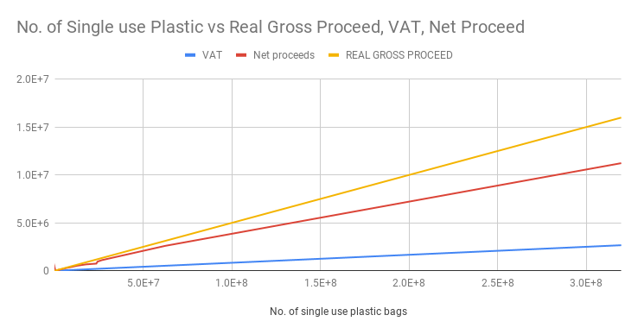
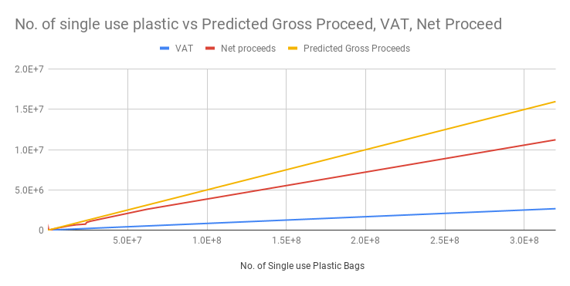
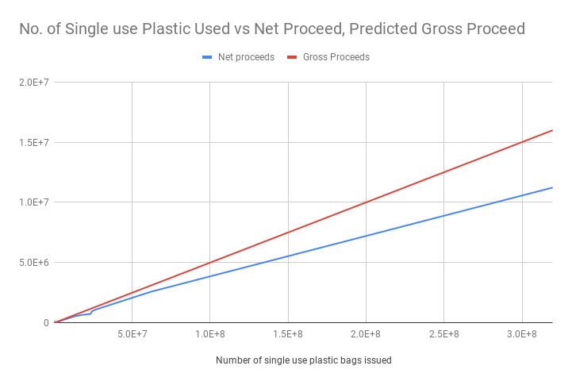
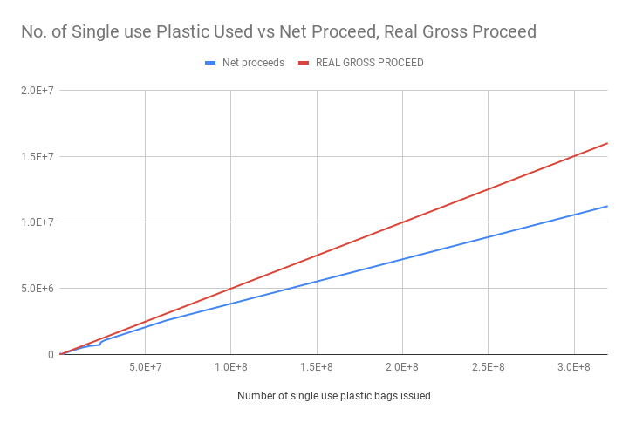

Slide 27
Sales Graph Inference
There will be a decrease in future expenditure in manufacturing plastics.
UK companies will start decreasing their use and manufacturing of these plastics thus adhering to the Anti Plastic Pact signed by the companies in the UK.
Companies are yet to cut down on the usage of single-use plastic.
A significant decrease in the future production of single-use plastics will help reduce the sale to a significant extent. Companies are yet to cut down on the usage of single-use plastic.
The actual gross expenditure and the predicted gross expenditure in the above all four graphs remains the same.
This shows that the government enforced mechanisms have not yet shown their effect. The annual supply and sales of plastic in future will continue to keep increasing among the companies.

Slide 28
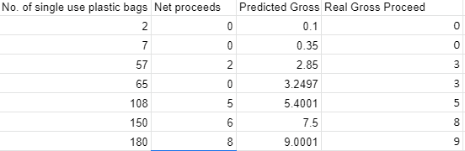
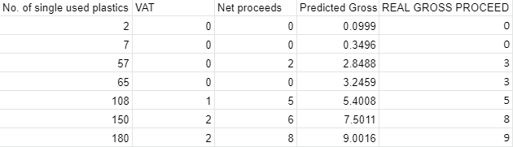
TOP Figure: Head of 7 values - without VAT
BOTTOM Figure: Head of 7 values - with VAT

Slide 29
Sales Data Head Inference
The two data sets in the above figure are compared to understand the minute change in the predicted gross expenditure.
Micro changes in predicted gross in the data head are nearly indistinguishable to the naked eye.
The data set with VAT shows less predicted expenditure on plastic, while the one without VAT depicts a linear increase in the future sales and consumption of single-use plastic.
Thus showing the role of government in controlling the production of single-use of plastic.
The strict mechanism enforced by the UK government will force the companies to automatically reduce the manufacturing and consumption of plastic.

Slide 30
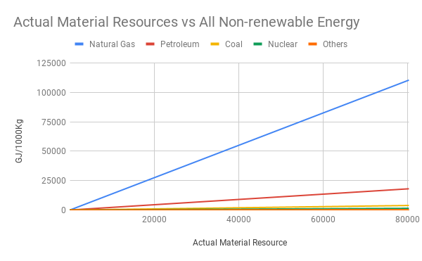
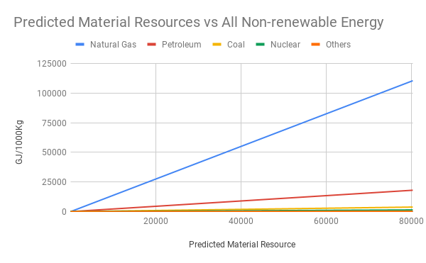
Actual Material Resources vs All non-renewable Energy in Huber Regression
Predicted Material Resources vs All non-renewable Energy in Huber Regression

Slide 31
Energy & Resource Consumption Inference
Material Inference
The above figures depict the excessive level of over-consumption of the depleting natural resources. A large amount of natural gas is processed and consumed to prepare low-density polyethylene.
Petroleum comes second in position with total energy consumption. Very little energy is consumed from the remaining resources (coal, nuclear, others).
In both the graphs the energy consumption for all resources continues to steeply increase. This depicts the harmful habits of companies to over-consume non-renewable resources.

Slide 32
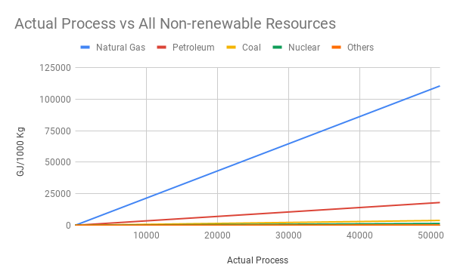
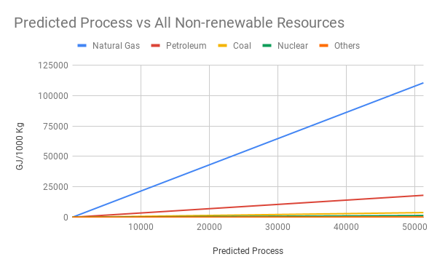
Actual Process Resource vs All non-renewable Energy in Huber Regression
Predicted Process Resource vs All non-renewable Energy in Huber Regression

Slide 33
Process Inference
The process graph shows comparison between actual energy consumption in the process phase
Natural gas consumes maximum energy to prepare low-density polyethylene. Similar to the material phase, petroleum comes second with total energy consumption.
The curve for other gasses has almost merged in the graph as they consume very minimal energy which is almost invisible to the eye.
The consumption curve for the process phase is similar to the material phase.
This tells us how companies continue to over-consume resources

Slide 34
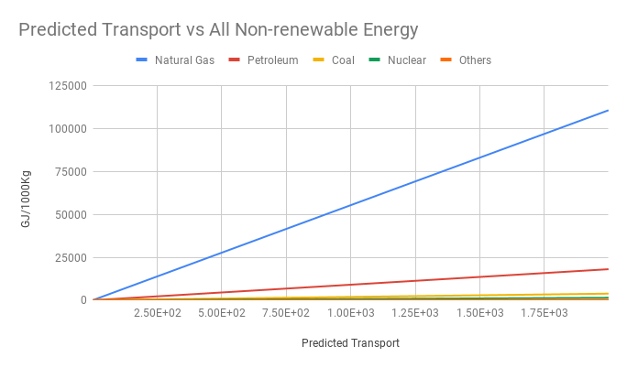
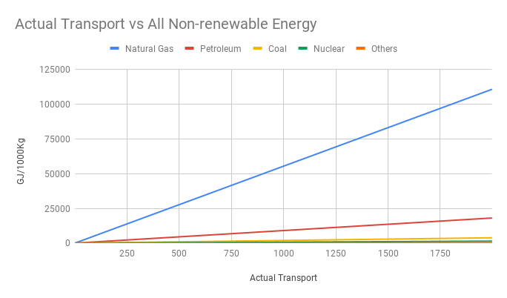
Predicted Transportation Resource vs All non-renewable Energy in Huber Regression
Actual Transportation Resource vs All non-renewable Energy in Huber Regression

Slide 35
Transport Inference
Once again natural gas and petroleum bag the first two position for the energy consumption in the transportation phase.
However, there is a huge difference in the curve for the energy consumption of petroleum and natural gas.
This indicates that in comparison to petroleum, natural gas is consumed in much more amount. This was not the case for the process and manufacturing phase.

Slide 36
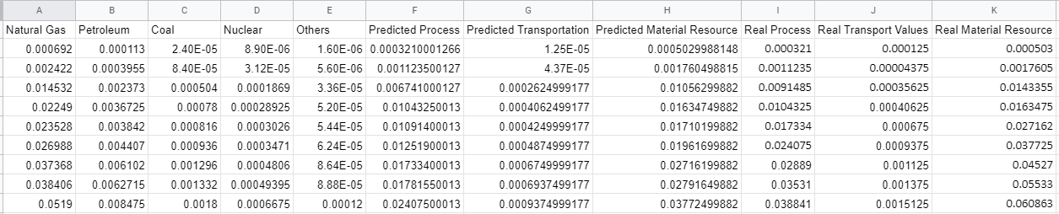
Head of top 9 values from combined Process, Transportation and Material Phase

Slide 37
Combined Resource Inference
Energy consumption from non-renewable resources is maximum during the manufacturing of the plastic (process phase). Transportation of raw materials (transportation phase) comes second and the extraction of raw materials to manufacture plastics comes in the third position
The companies in the UK show an increase in the future trend of the production of more plastic. This is evident as the predicted process values are more than the real process values.
The only way to reduce production is by increasing the tax rate per production. This will create a demand reduction thus reducing excessive use of petroleum and natural gas.
An opposite trend is noticed in the real transportation value and predicted value of transportation. This is opposite to the process phase. This shows that the rate of energy consumption in the transportation phase will decrease in future.
The energy consumption in the material phase for both predicted and real value is nearly negligible when compared to values from the production and transportation phase.

Slide 38
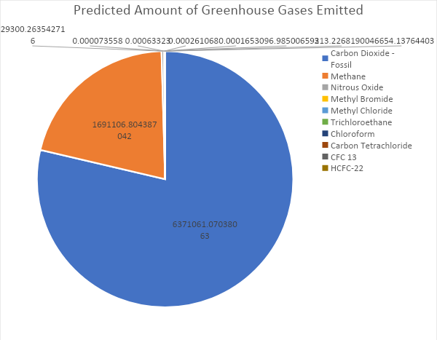
Predicted Amount of Greenhouse Gases Emitted during all phases (in 1000 Kg)

Slide 39
Greenhouse Emission Inference
Carbon Dioxide (78.67%) and Methane (20.88%) are produced the most followed by other pollutants. This is because petroleum and natural gas resources are highly over consumed to manufacture single-use plastics. In the transportation phase, a lot of coal along with petroleum and natural gas is also used as fuel.
They are the major sources of trapped methane gas. When these resources are over consumed, deadly methane and Carbon dioxide are released into the air.
In the transportation phase, a lot of coal along with petroleum and natural gas is also used as fuel. This releases harmful pollutants.
Both the pollutants capture heat and don’t allow them to escape from the earth’s surface. Thus making the air extremely hot and increasing the danger of climatic tipping point. This will have a devastating effect on the climate of the planet.
Methane is a deadlier greenhouse pollutant as it remains in the atmosphere for a longer time than Carbon Dioxide. The steep rise in the curve in all three phases can cause many health issues like vision problems, memory loss, nausea, vomiting, facial flushing and headache.
The remaining pollutants together constitute only a micro amount of 0.44 % of the total pollution. So on controlling the rate for methane and Carbon Dioxide, then the planet's temperature will be controlled.

Slide 40
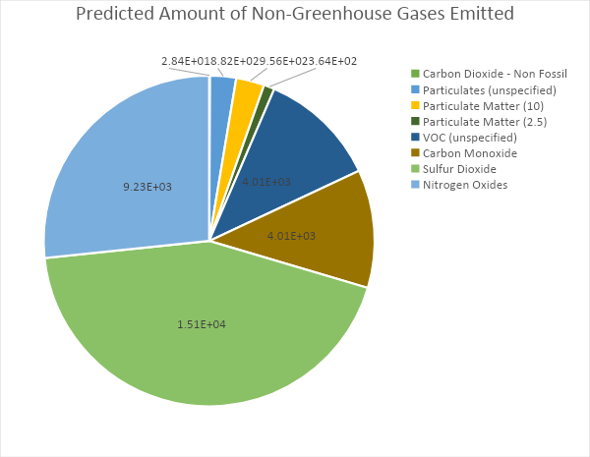
Predicted Amount of Non-Greenhouse Gases Emitted during all phases (in 1000 Kg)

Slide 41
Non-Greenhouse Emission Inference
Approximately 43.5% of Sulphur dioxide is produced during the process. This is an alarming issue as such high percentage damages the ecological system and also responsible for deteriorating heritage buildings. They also cause shortness of breath and chest tightness in humans.
Nitrogen Oxides forms 27% of the total non-greenhouse gasses that are emitted. They are responsible for damaging the vegetation, affecting animals and human beings. This pollutant cause Eye irritation, lung problem and breathing issue.
They combine with Sulphur Dioxide which is also emitted in abundance to produce acid rain. Acid rain chemically reacts with buildings and statues and dissolve the chemicals thus making them weak and brittle.
In comparison to others, Carbon monoxide and VOC are produced at a decent rate of 12%. Carbon monoxide is still as carbon monoxide above 40% these pollutants become lethal to human and animal lives.
Particulate Matter (unspecified, 10 and 2.5) are emitted in very micro amounts in comparison to the other pollutants These are majorly micro and nano fine particles that are the main contributors to indoor pollution.
They have a significant impact on human health. These are a complex mixture of extremely small particles and liquid droplets. These pollutants are deadly in nature and are responsible for even deaths when emitted at a huge level.
Carbon Dioxide fossil emission is almost negligible. However, they are less deadly than the other pollutants if produced in high concentration can lead to coma or death.

Slide 42
ACCURACY OF THE MODEL
Ridge Regression: 0.9995181393016049
Huber Regression: 0.9999968840663866
Linear Regression: 0.9999275764740482
Huber> Linear> Ridge
This is because it is less sensitive towards outliers or abnormalities in a data.
Limitations: Certain values of net, gross and vat were not available, so they were assumed 0 by default.

Slide 43
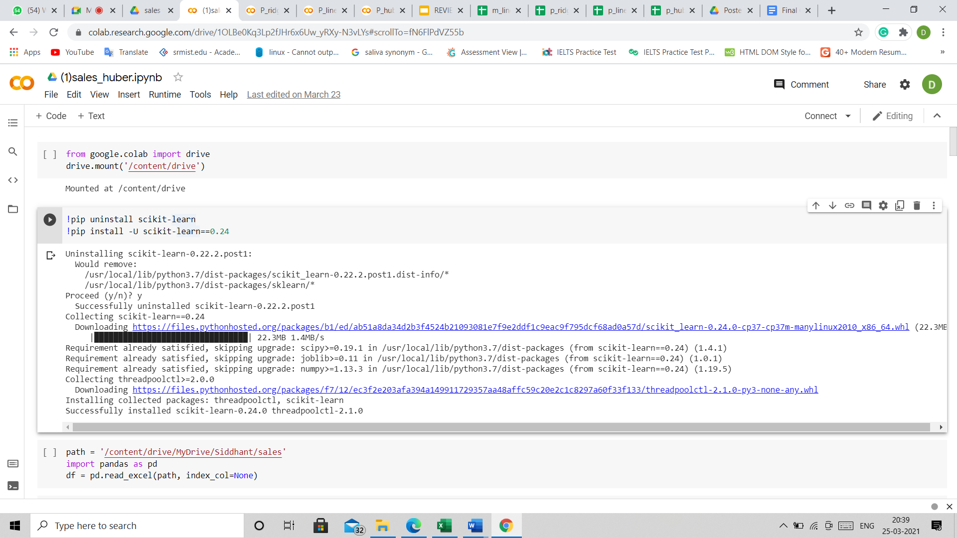
Appendix
CODE SNIPPET :SALES WITH VAT HUBBER

Slide 44
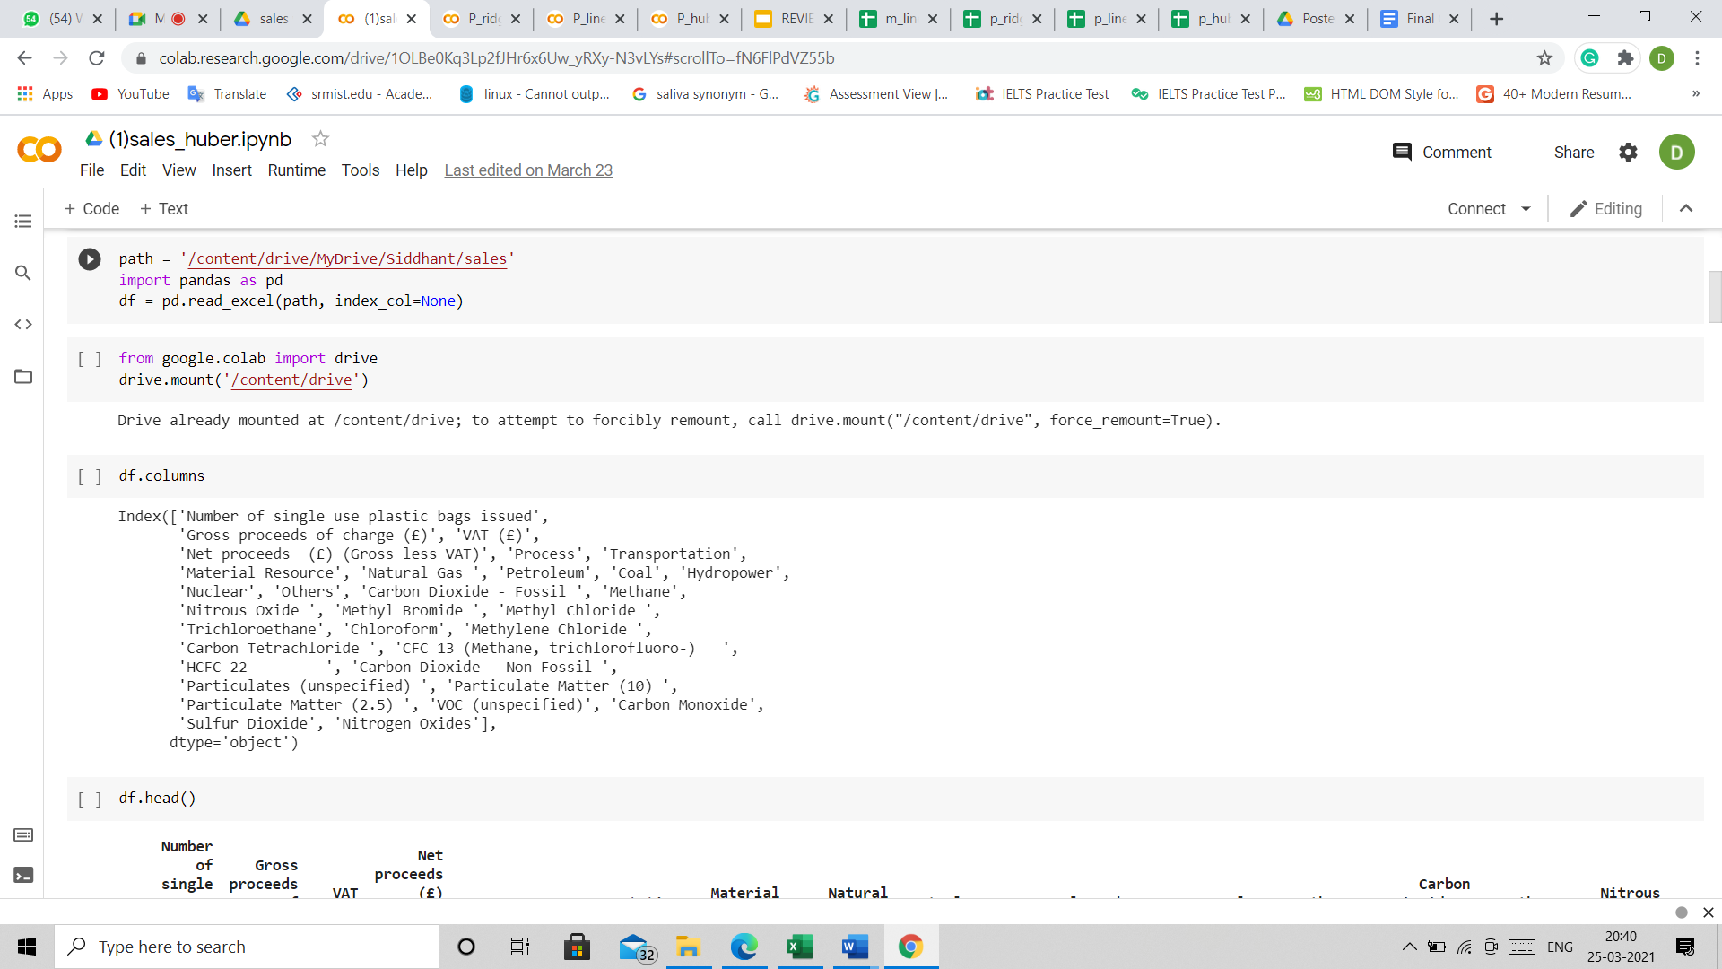

Slide 45
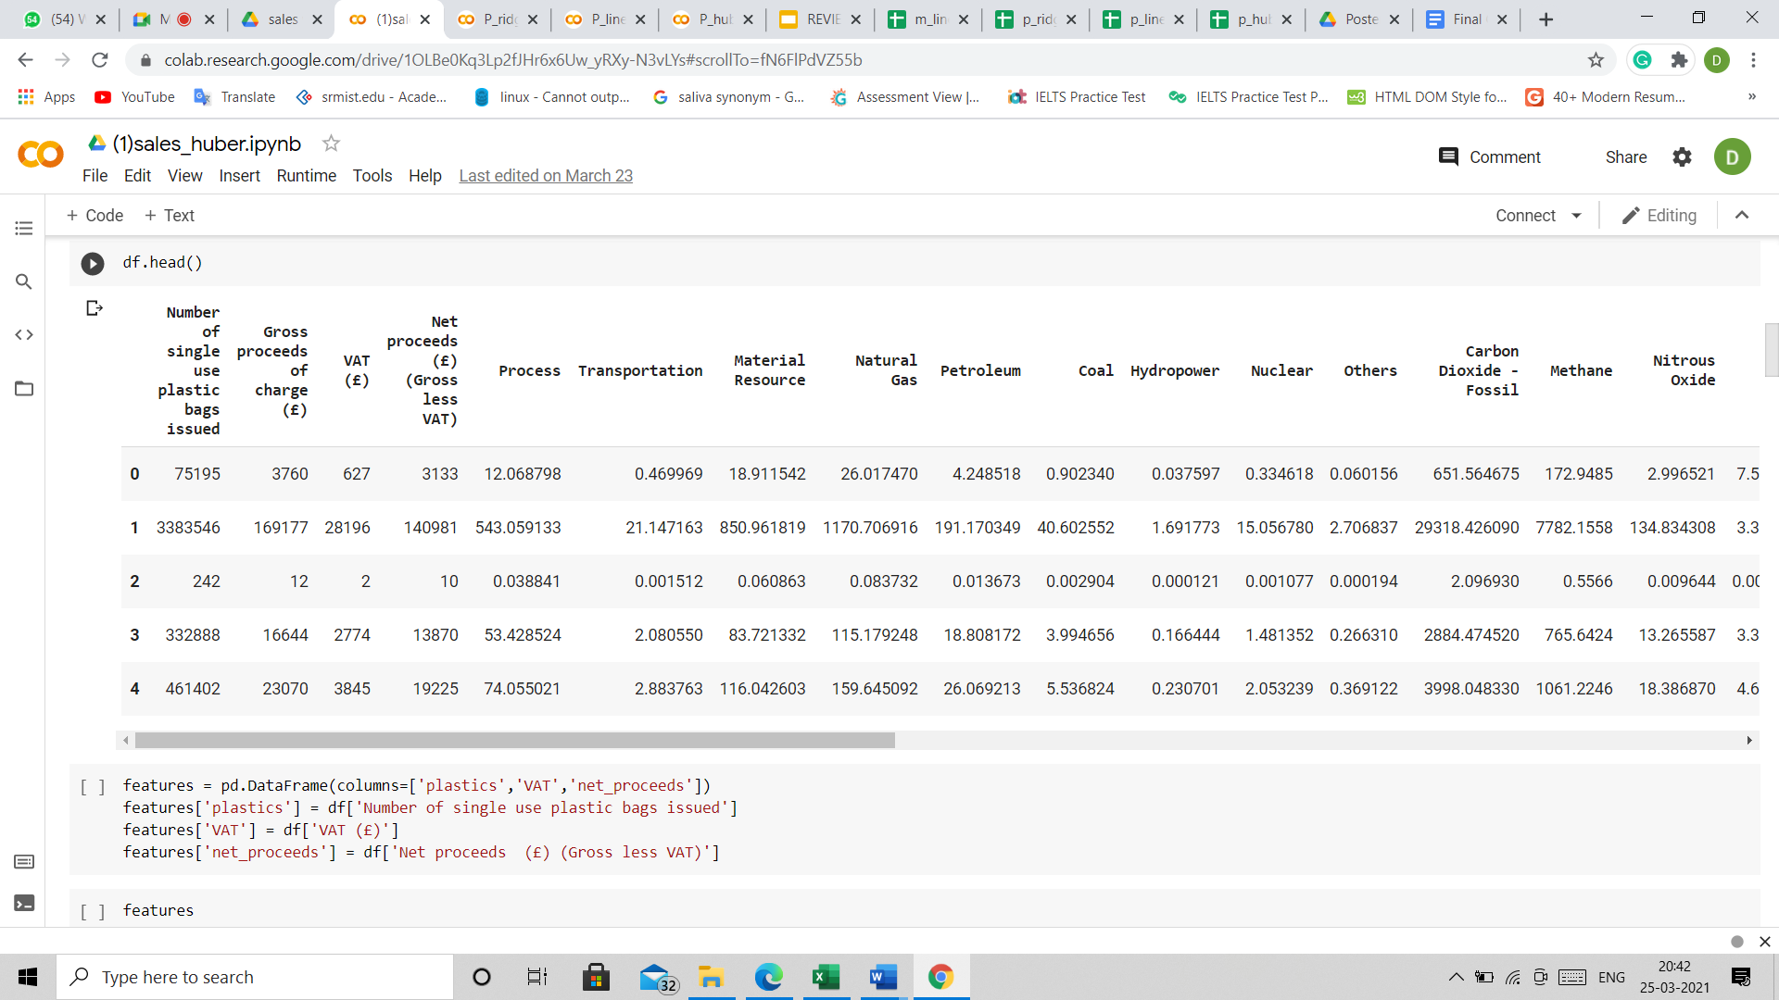

Slide 46
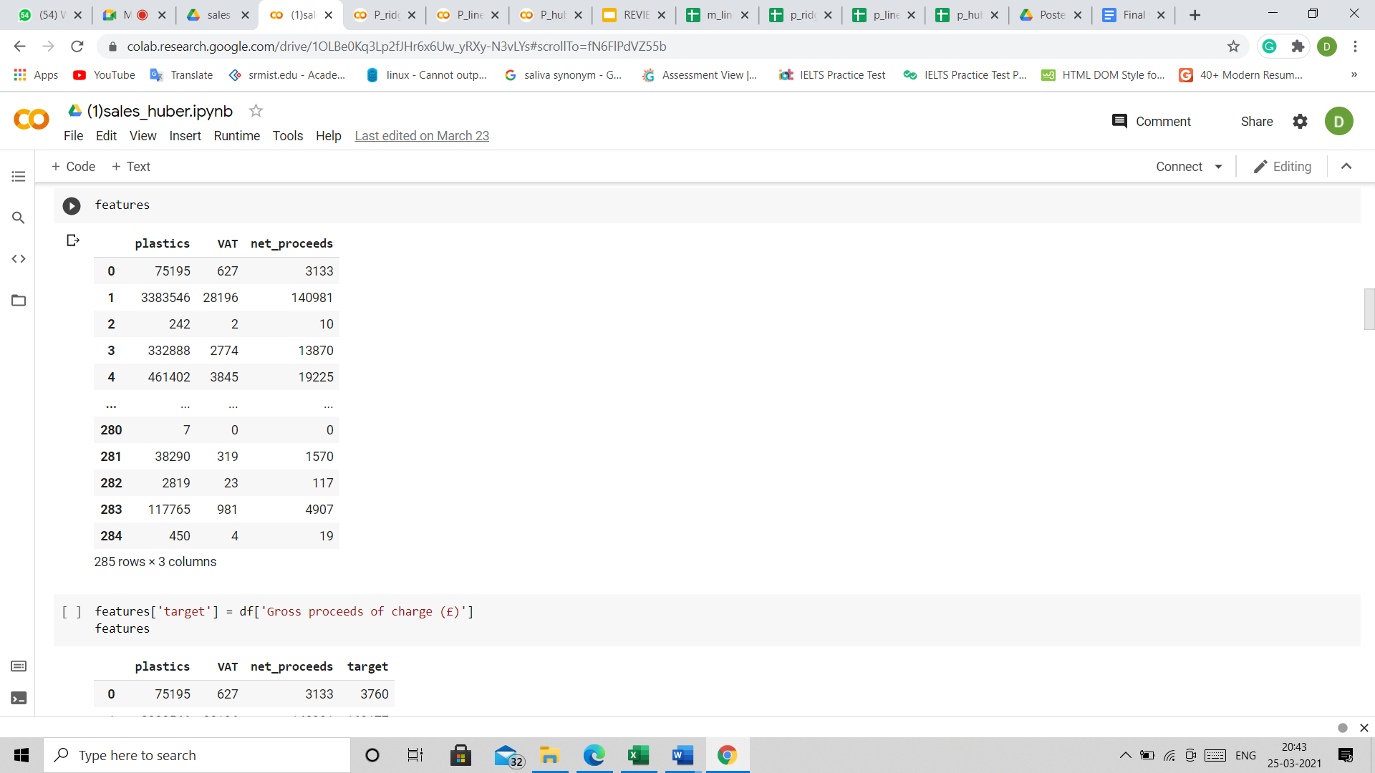

Slide 47
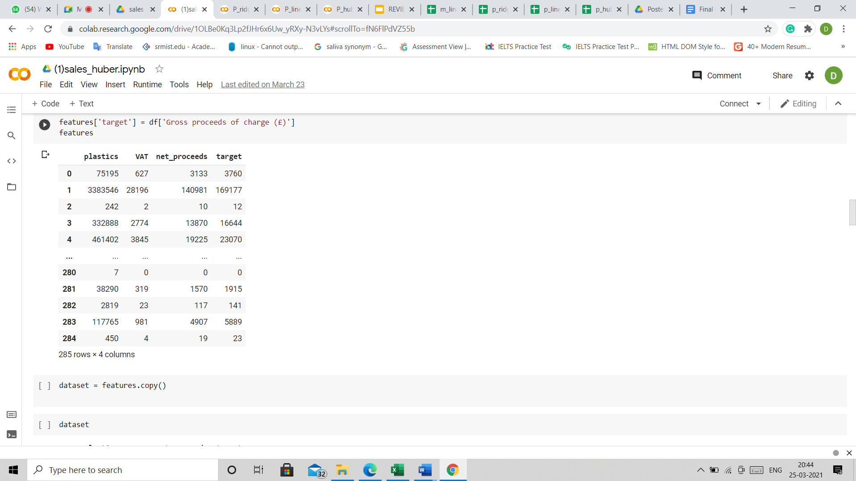

Slide 48
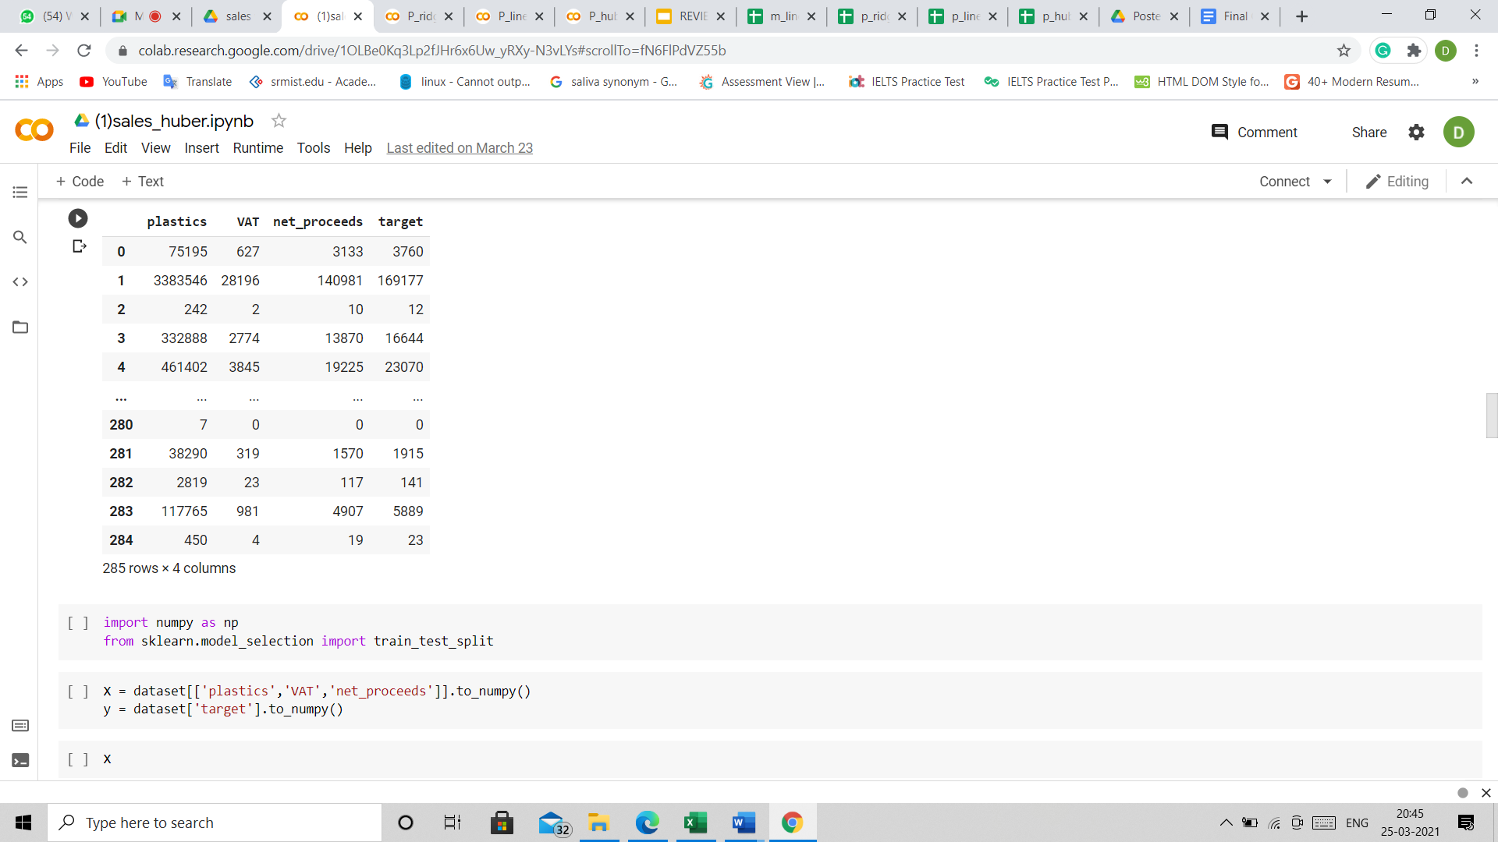

Slide 49
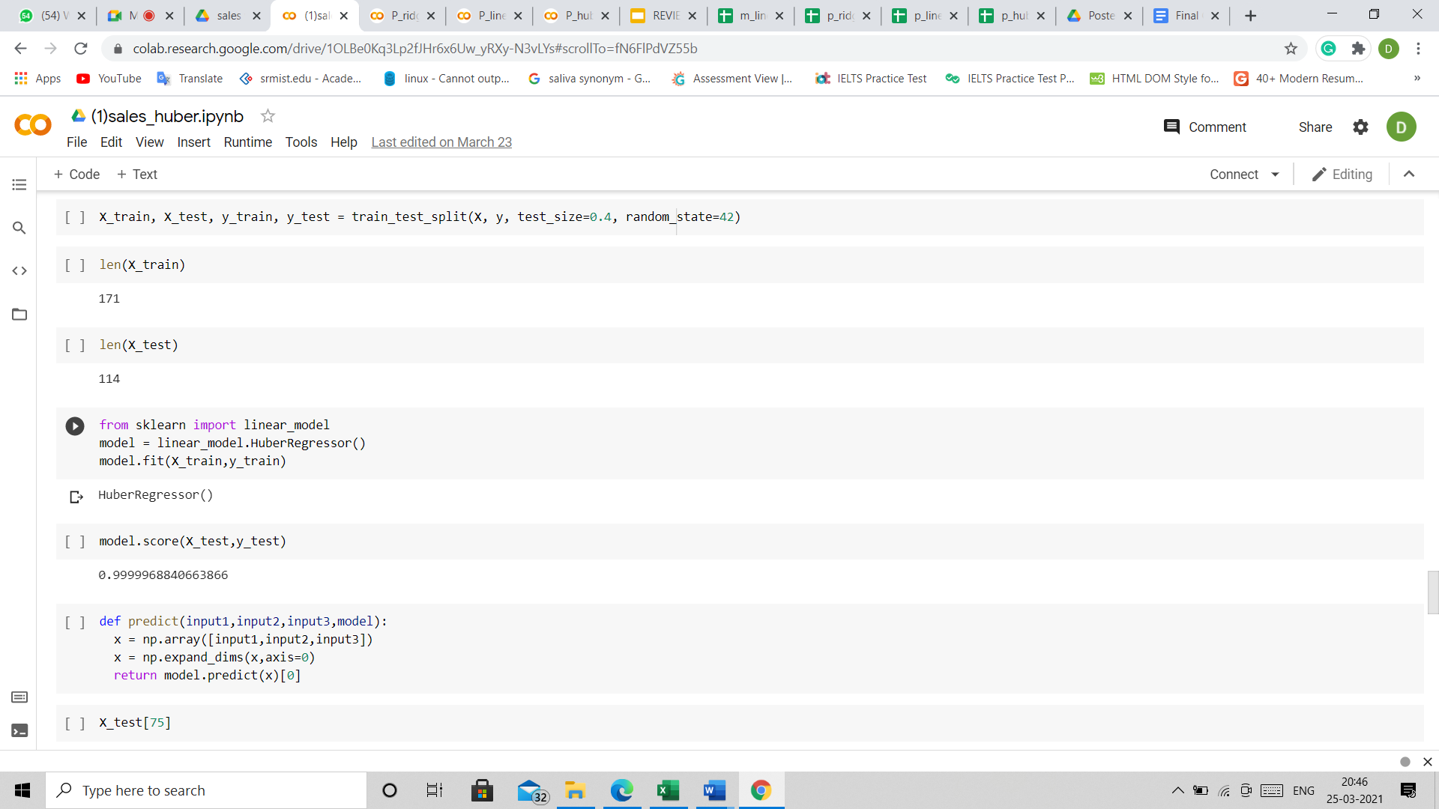

Slide 50
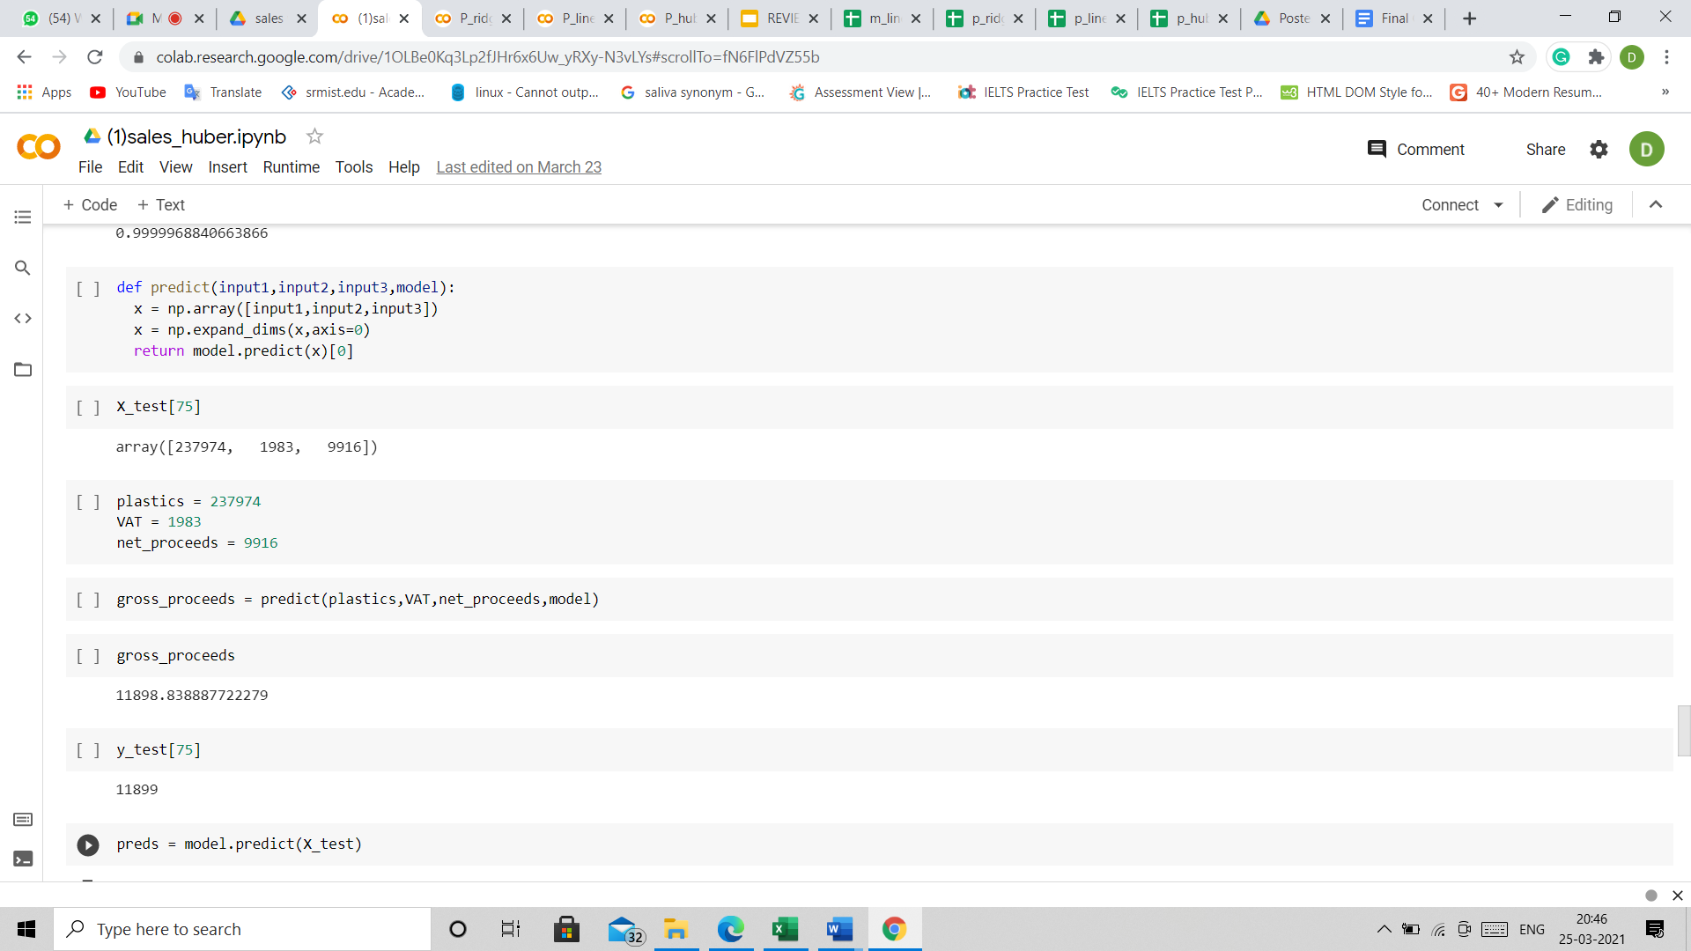

Slide 51
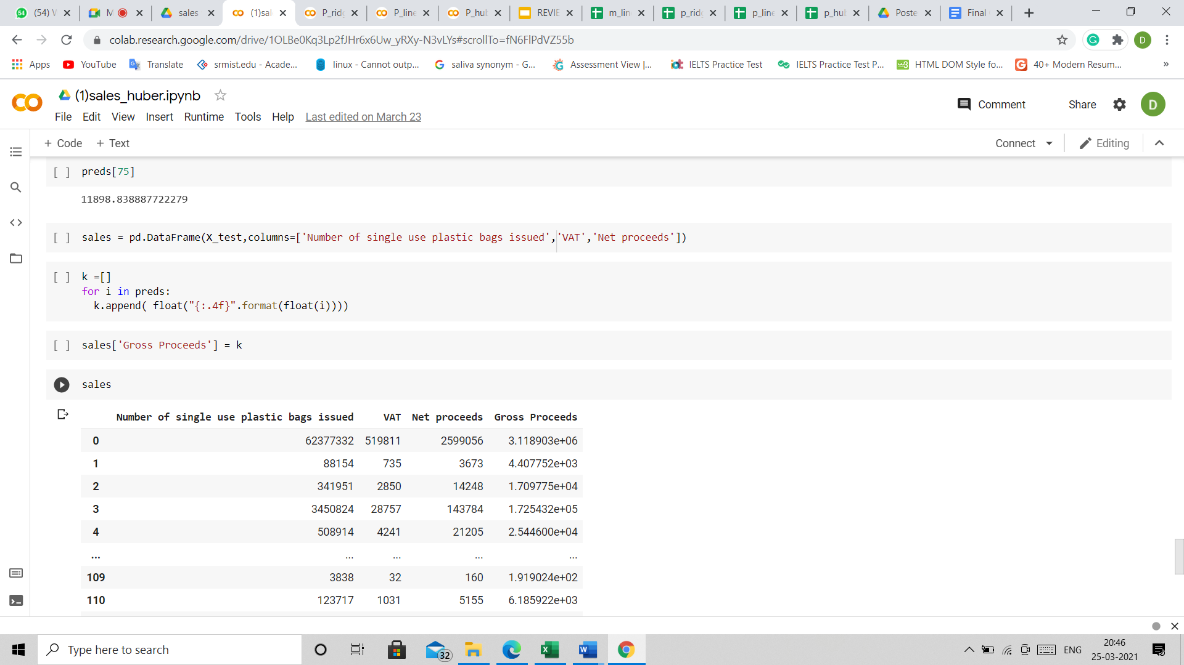

Slide 52
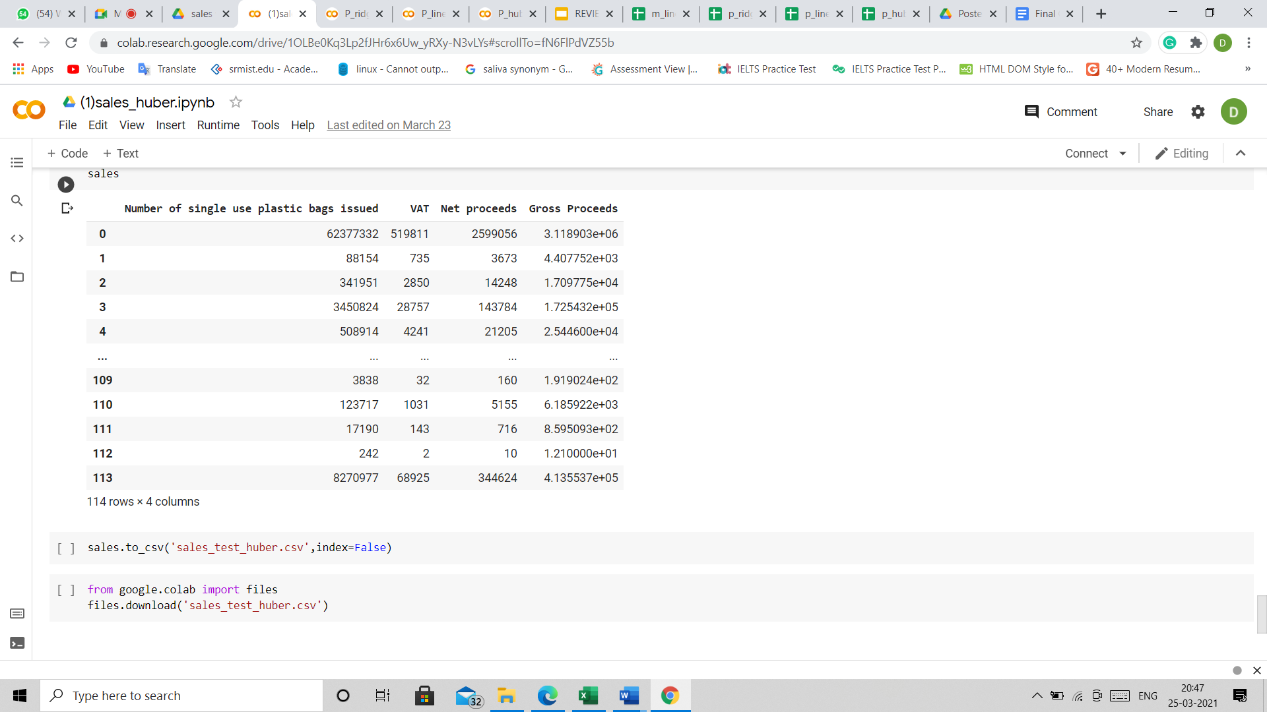

Slide 53
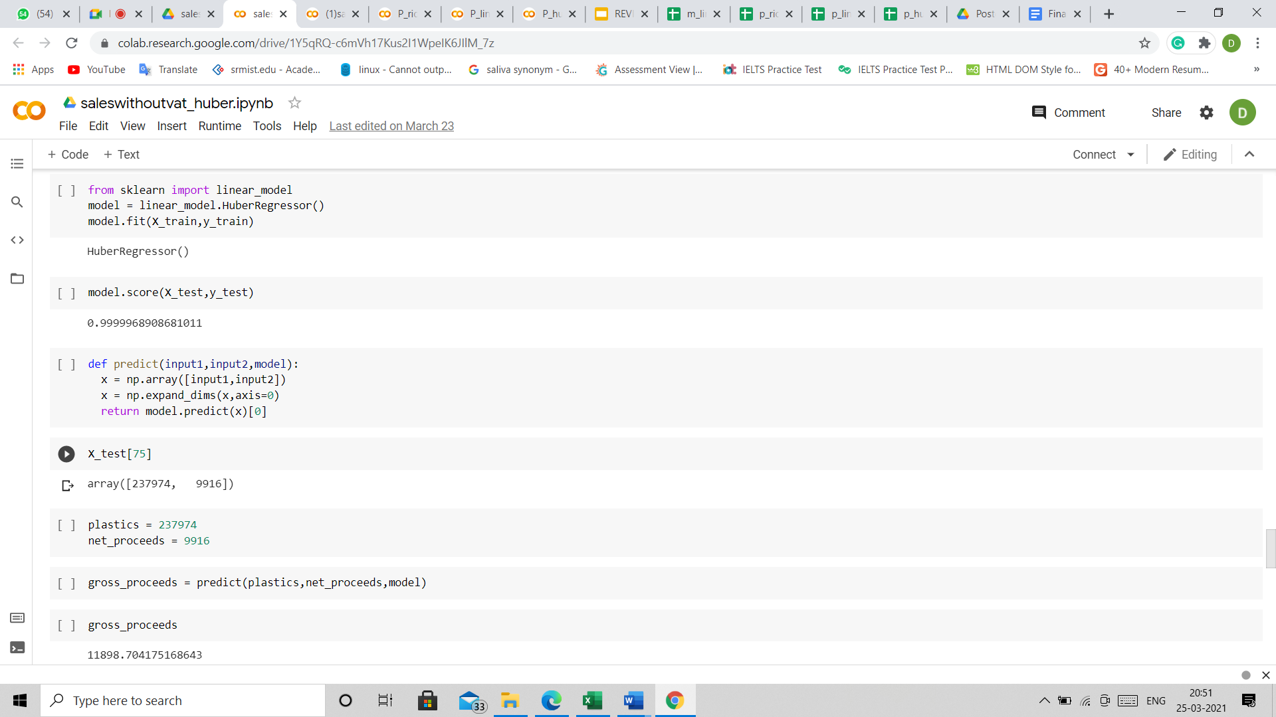
CODE SNIPPET :SALES WITHOUT VAT HUBBER

Slide 54
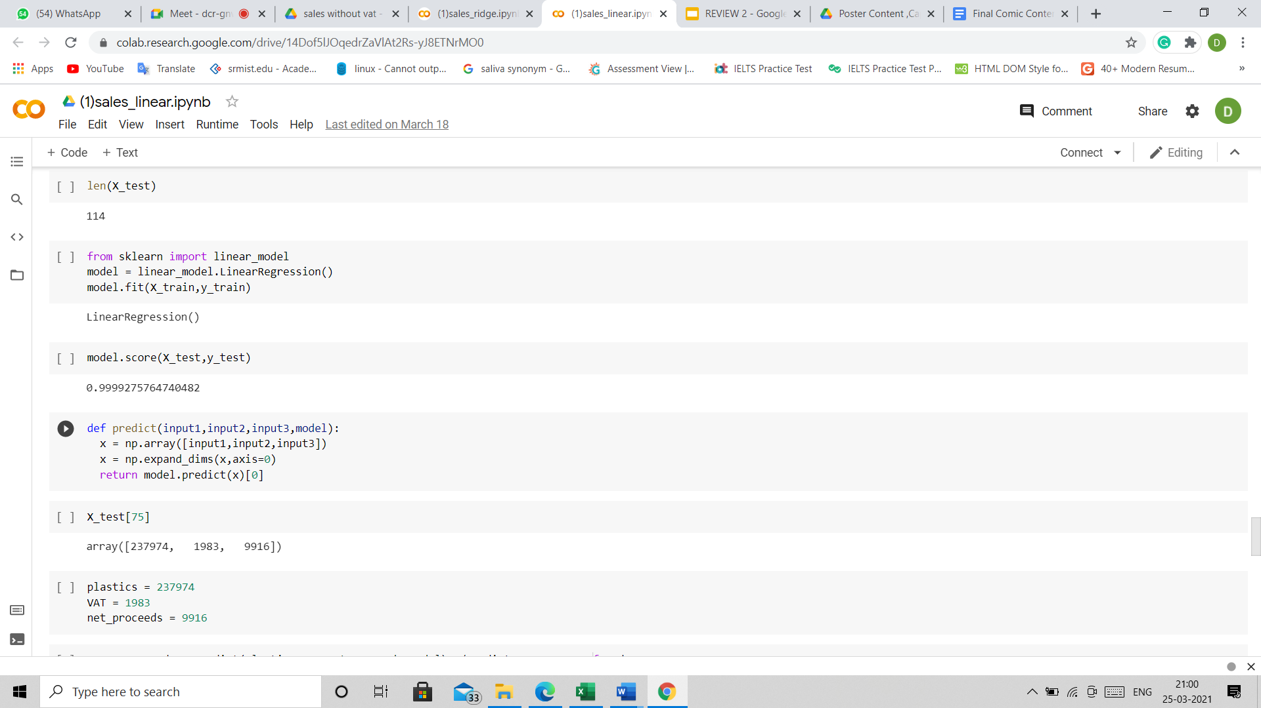
CODE SNIPPET :SALES WITH VAT LINEAR

Slide 55
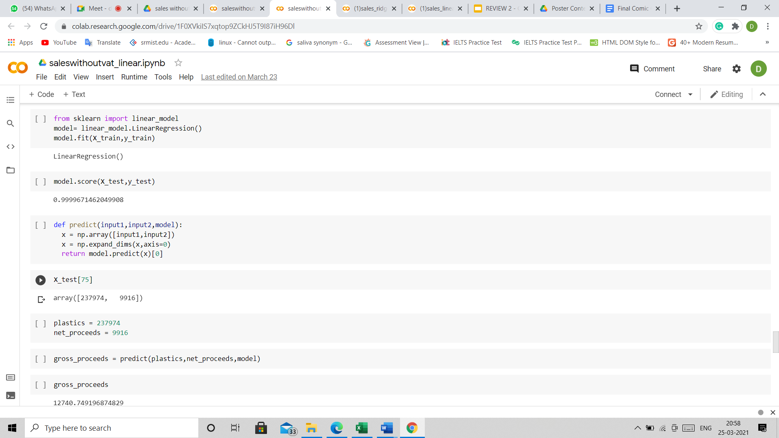
CODE SNIPPET :SALES WITHOUT VAT LINEAR

Slide 56
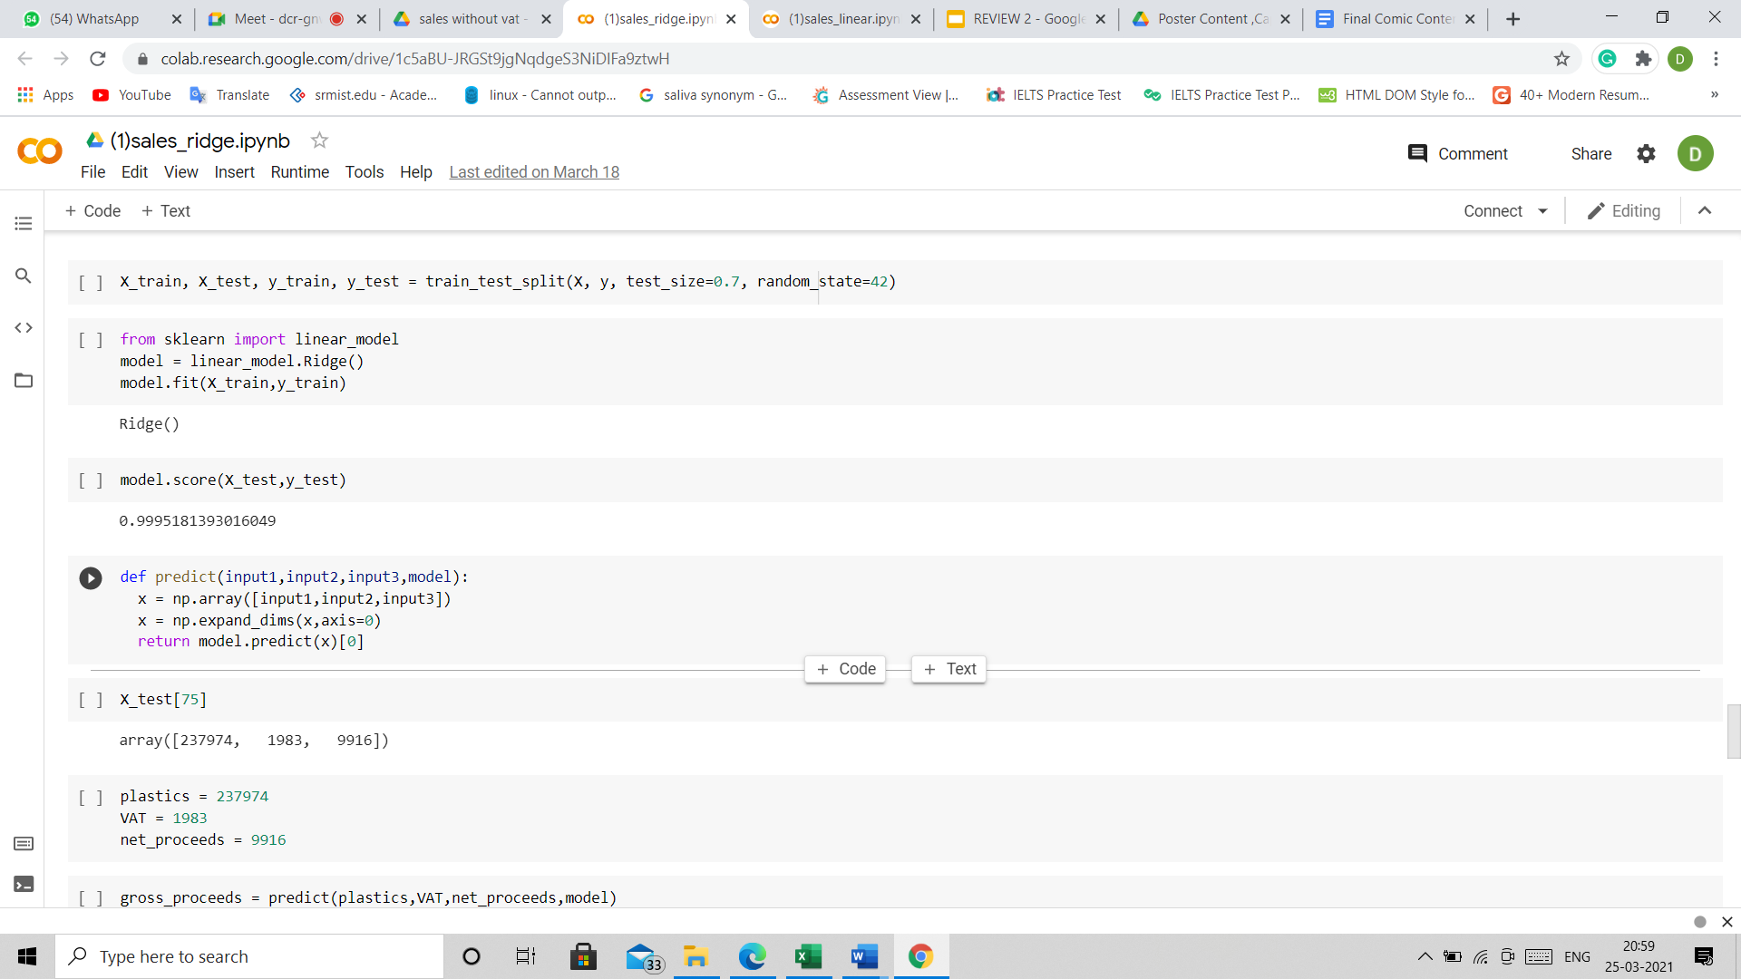
CODE SNIPPET :SALES WITH VAT RIDGE

Slide 57
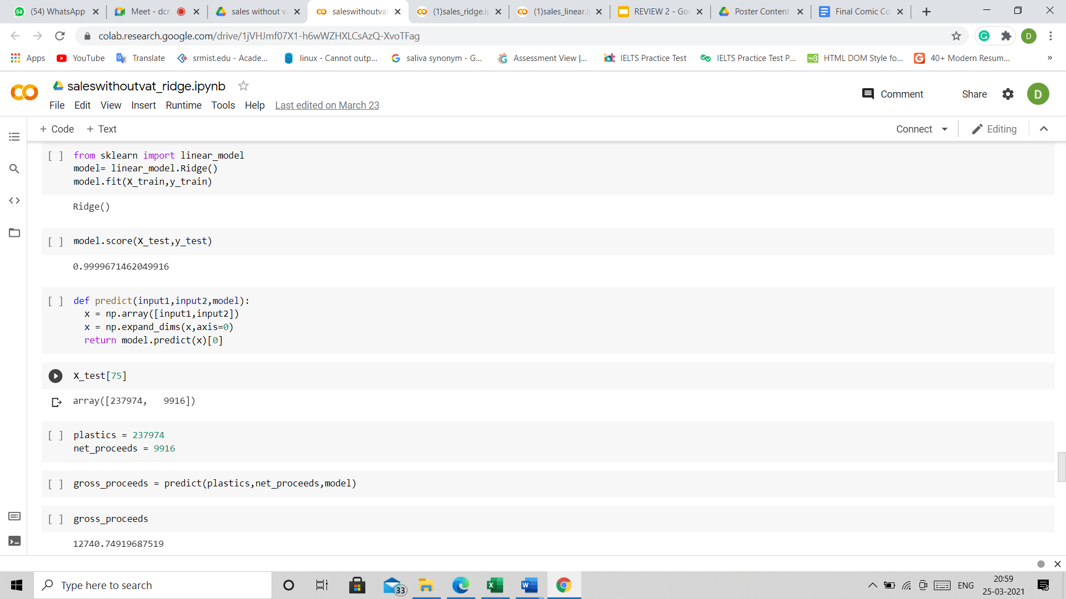
CODE SNIPPET :SALES WITHOUT VAT RIDGE

Slide 58
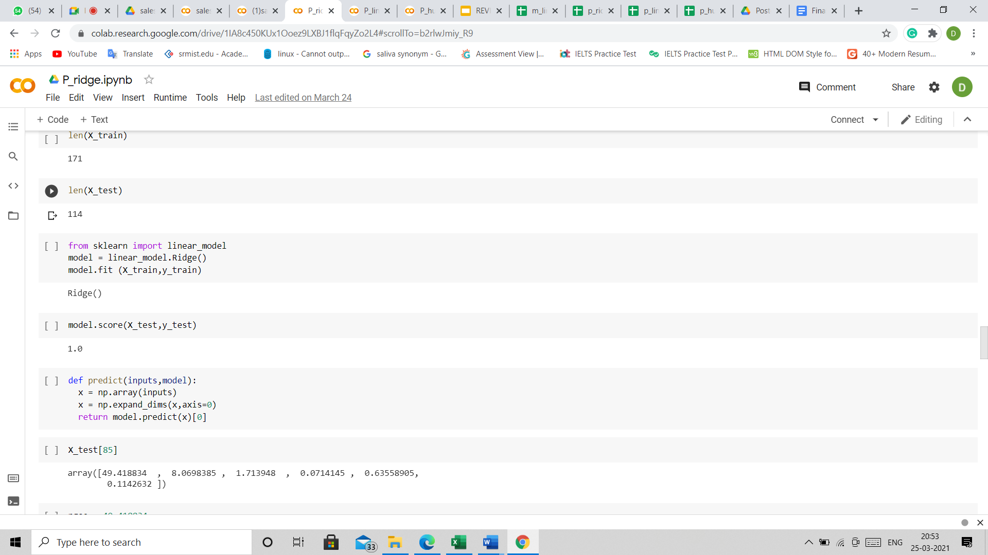
CODE SNIPPET :PROCESS RIDGE

Slide 59
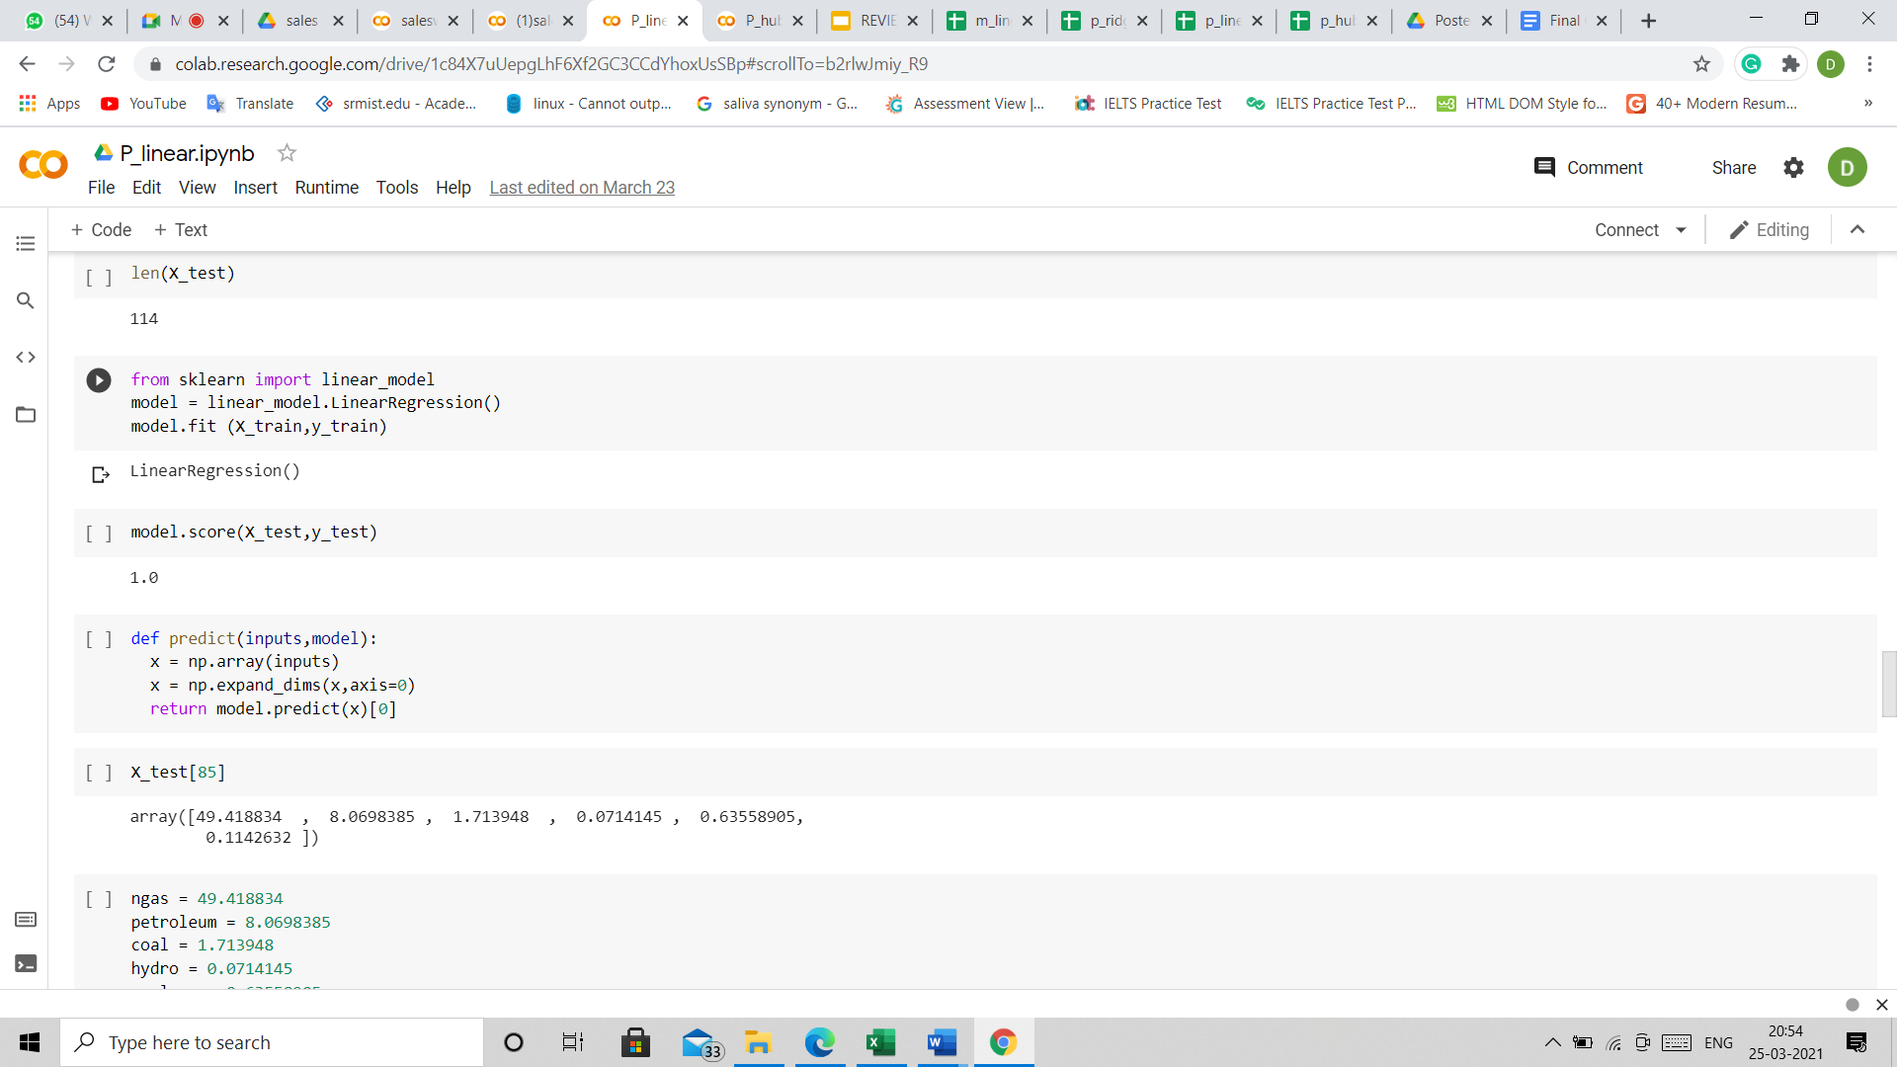
CODE SNIPPET :PROCESS LINEAR

Slide 60
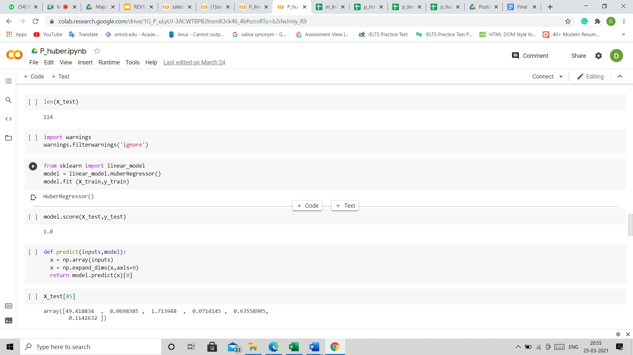
CODE SNIPPET :PROCESS LINEAR

Slide 61
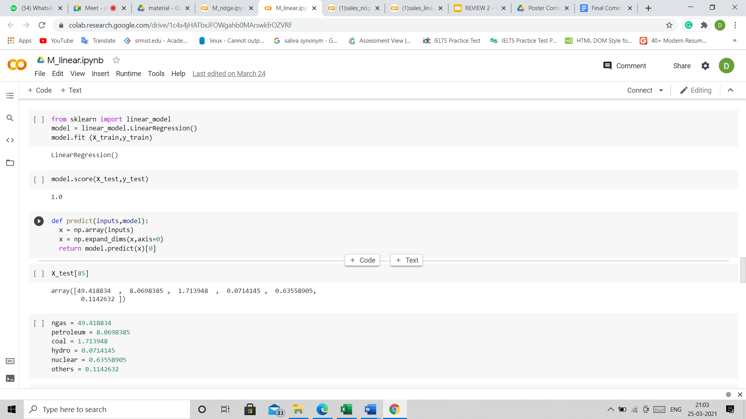
CODE SNIPPET: MATERIAL LINEAR

Slide 62
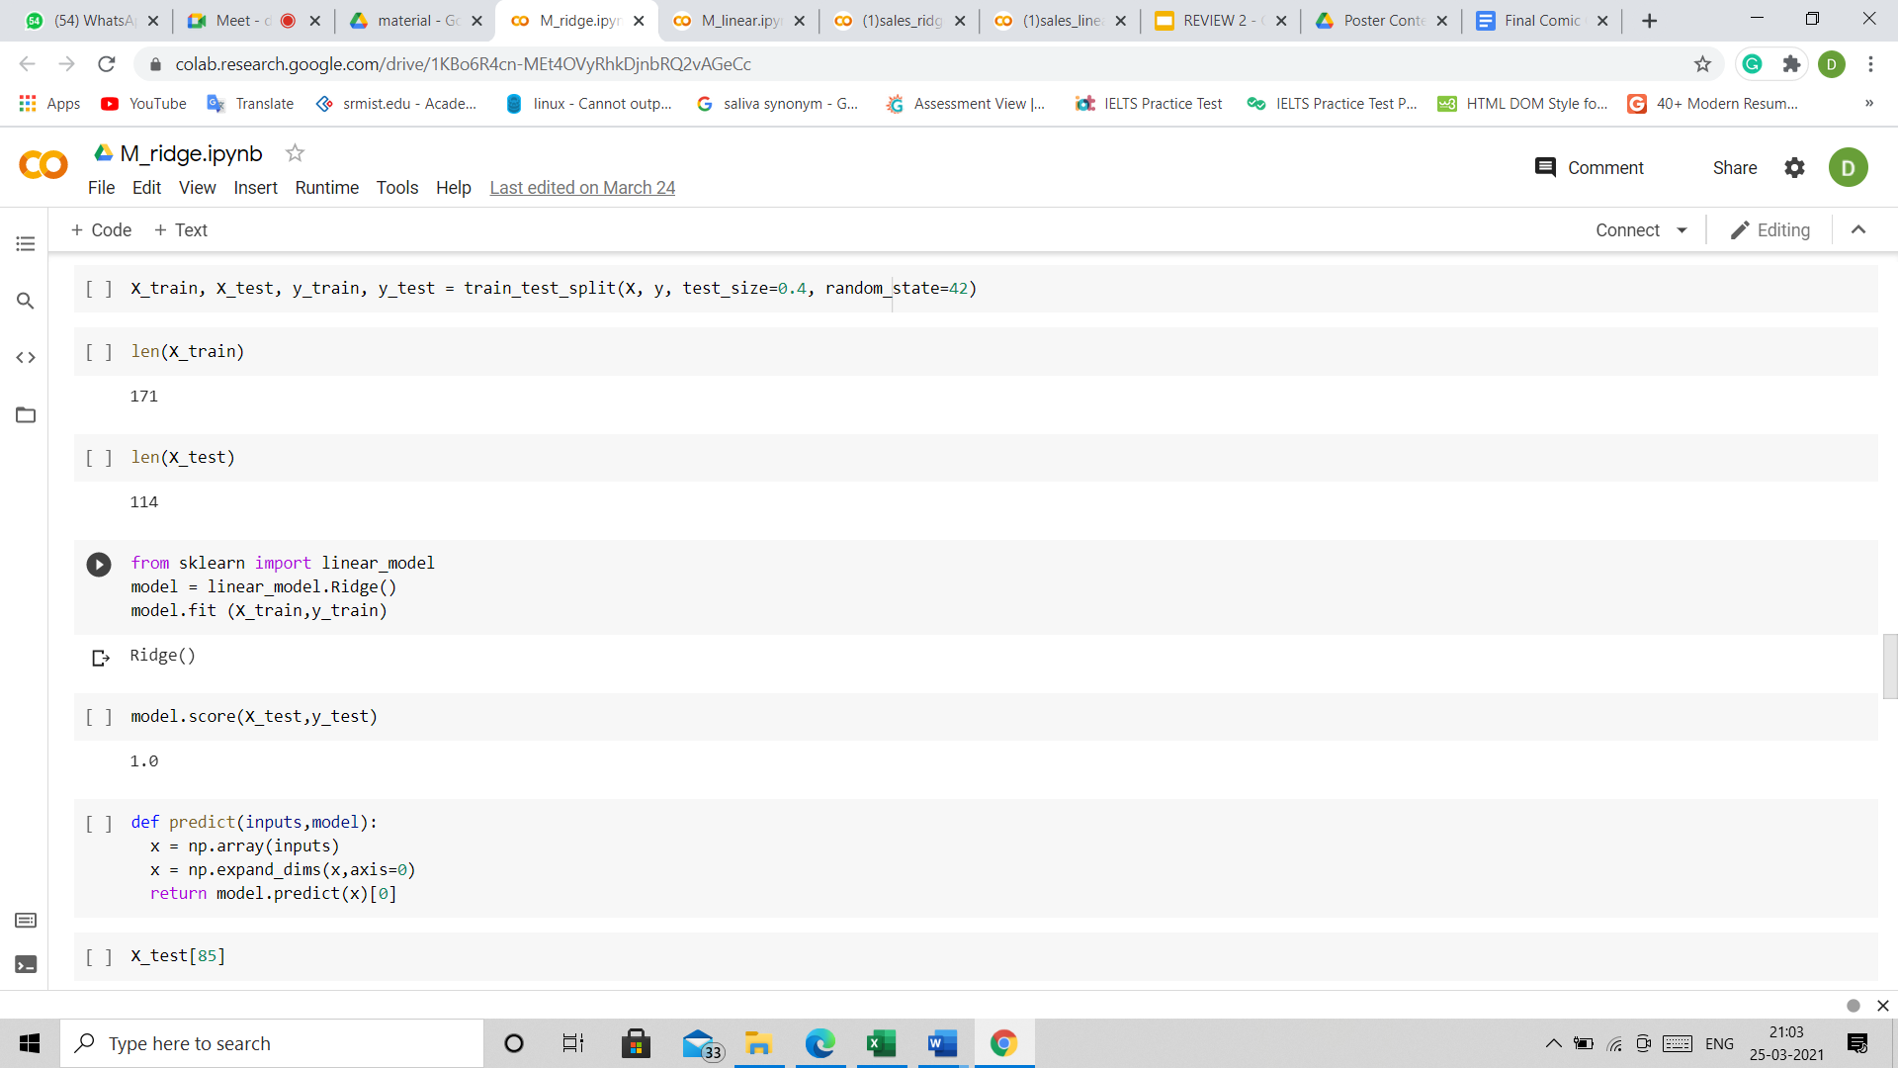
CODE SNIPPET :MATERIAL RIDGE

Slide 63
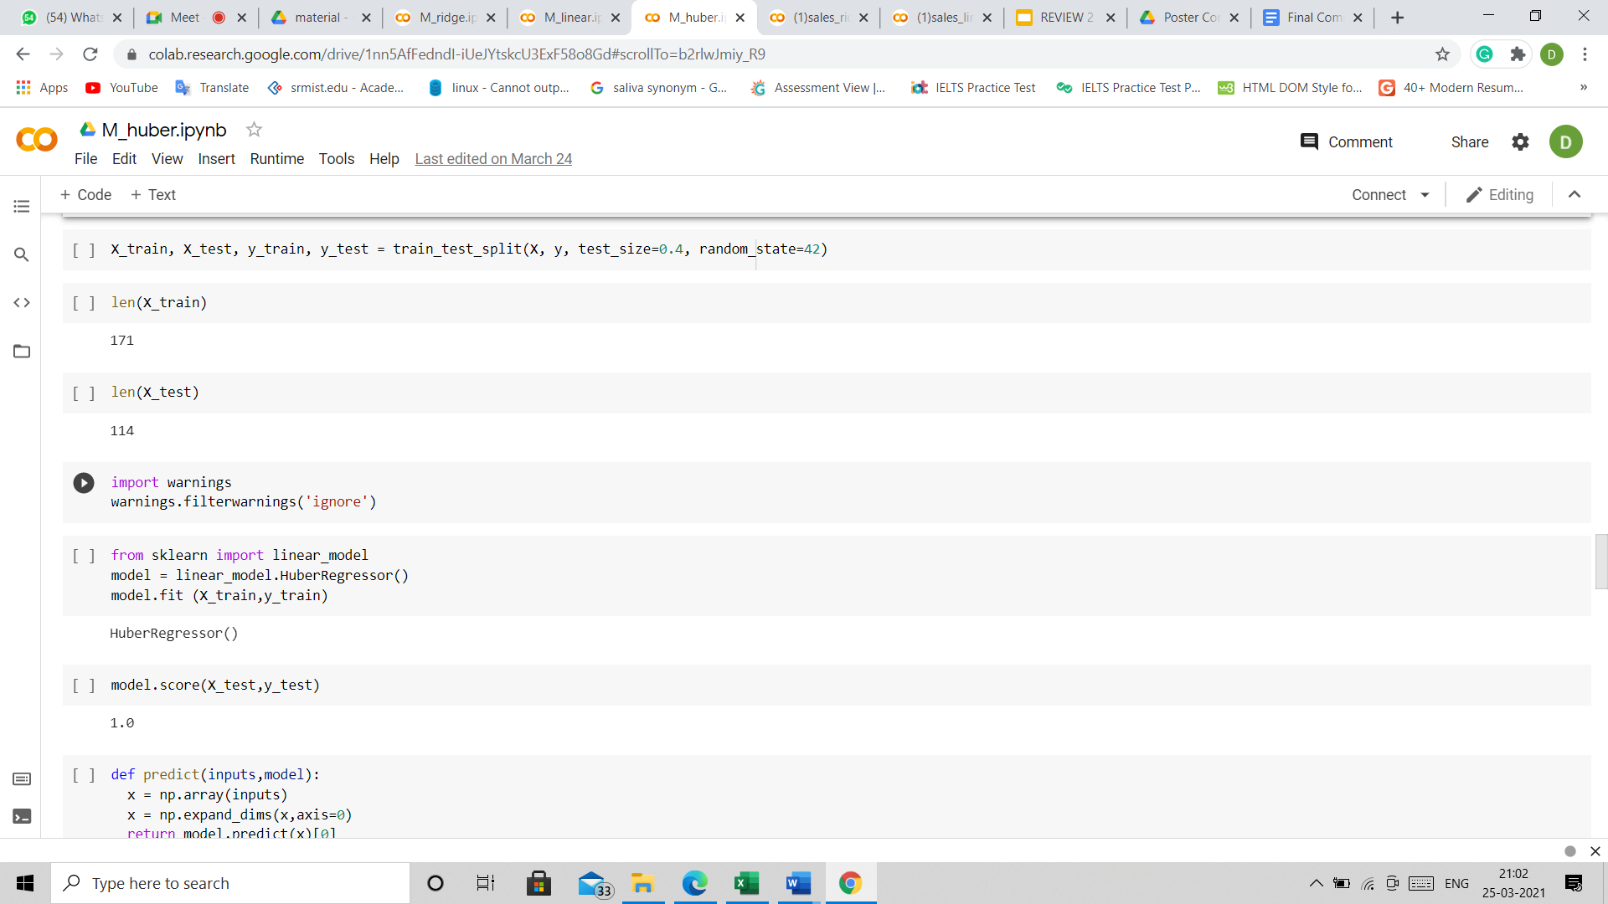
CODE SNIPPET :MATERIAL HUBER

Slide 64
References
Liu, Zhi-Chao & Jiang, Qiuhong & Zhang, Hong-Chao. (2012). Life Cycle Assessment Model: Recent Development and Future Tendency. https://www.researchgate.net/publication/259241235_Life_Cycle_Assessment_Model_Recent_Development_and_Future_Tendency
Ji-Hyung Park, Kwang-Kyu Seo, A knowledge-based approximate life cycle assessment system for evaluating environmental impacts of product design alternatives in a collaborative design environment, Advanced Engineering Informatics, Volume 20, Issue 2, 2006, Pages 147-154, ISSN 1474-0346, https://doi.org/10.1016/j.aei.2005.09.003
Rosanna Fornasieroa, Carlo Brondia and Davide Collatinaa, International Journal of Computer Integrated Manufacturing, 2017
Alfred Degbotse, Ai Kiar Ang, Ngoc Quy Vuong, Julian SK Tan, 2017 19th Electronics Packaging Technology Conference.
Shridhar Kamble, Aaditya Desai and Priya Vartak, 2015 International Conference on Communication, Information & Computing Technology (ICCICT), Jan. 16-17, Mumbai, India.
Elisa CohaS, Chris Hendrickson, Lester Lave and Francis McMichaell, 1995 IEEE International Symposium on Electronic and the Environment Proceedings, Orlando, FL.
Rosanna Fornasiero, Carlo Brondi & Davide Collatina (2017) Proposing an integrated LCA-SCM model to evaluate the sustainability of customisation strategies, International Journal of Computer Integrated Manufacturing, 30:7, 768-781, DOI: 10.1080/0951192X.2016.1268716
William M. Barrett, Svetlana Strunjaš-Yoshikawa, Jonathan H Bell, 17th European Symposium on Computer Aided Process Engineering – ESCAPE17.
C. Brondi, E. Carpanzano, ITIA-CNR Institute for Industrial Technologies and Automation, National Research Council, 15 via Bassini, 20133 Milan, Italy.
Nasser Ayoub, Farayi Musharavati, Shaligram Pokharel, Hossam A. Gabbar, Risk based life cycle assessment conceptual framework for energy supply systems in large buildings, Journal of Cleaner Production, Volume 107, 2015, Pages 291-309, ISSN 0959-6526, https://doi.org/10.1016/j.jclepro.2015.04.075.
Dataset: https://ckan.publishing.service.gov.uk/dataset/single-use-plastic-carrier-bags-charge-data-for-england.

Slide 65
Publication Details
Published
S. Bhatta, D. Chakraborty and Poovammal E., Arriving at Optimal Cost for a Sustainable Product using an Integrated LCA-SCM Model, Journal of Information Technology in Industry, Vol. 9, No. 2, 2021, pp. 1193-1199, DOI: https://doi.org/10.17762/itii.v9i2.472
Journal Website: http://www.it-in-industry.org/index.php/itii Indexing: Web of Science, ISSN, Crossref, publons
Tech Blog Published. to ‘Towards Data Science’
Link:https://towardsdatascience.com/application-of-an-integrated-life-cycle-assessment-and-supply-chain-analytics-on-ldpe-6aba41555921

Slide 66
Manuscript Submitted
International Journal of Supply and Operation Management
Indexing: EBSCOhost, ISC, Scopus, Genamics, SID, OAJI, ProQuest, Journal Index, J-GATE, I2OR, Web of Science, etc.
Journal Website: http://www.ijsom.com/

